Slide 1

deploying HCL Cache With Redis
2020/04

Slide 2
Configuration
9.1 images to have HCL Cache pre-installed
HCL Cache provider is enabled at the cache level
Plan to configure all caches to hcl-cache provider
It’s possible to switch caches providers in server.xml or with providers run-engine-commands
Out-of-the-box all caches are local configuration only (not redis)

Slide 3
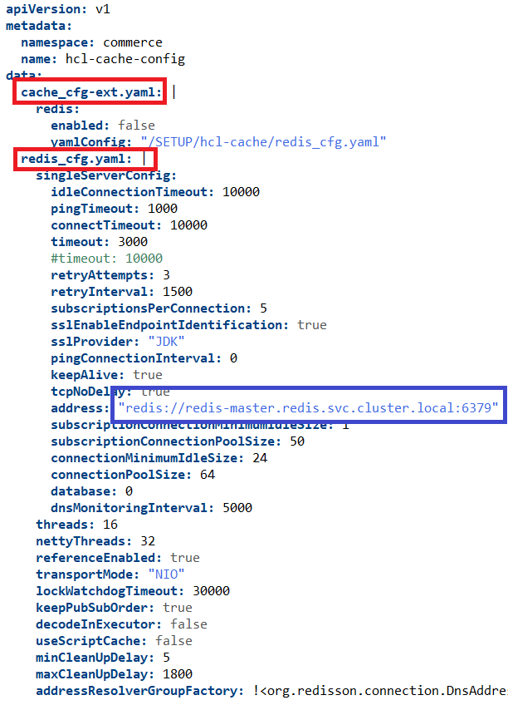
HCL Cache Configuration
Cache Configurations
Local only
Local + Remote (Redis)
Remote only
Cache is configured with a config map
(Docker compose steps to be sorted out)
redis_cfg.yaml
Configuration file from Redisson (Redis Client) in YAML format https://github.com/redisson/redisson/wiki/2.-Configuration
Allows for detailed tuning and configuration of the connections such as SSL, standalone, master-slave, clustered, etc
cache_cfg-ext.yaml

Slide 4
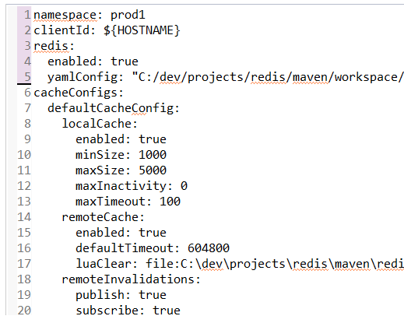
HCL Cache Configuration
cache_cfg-ext.yaml
YAML file used to configured the cache
Minimum configuration required:
If Redis is enabled, caches will use it
Cache size and size in MB are taken from Dynacache Configuration
Other configurations can be used to:
Configure cache statistics logger frequency (300 by default)
Disable/enable remote or local interfaces
Hard-limit maximum inactivity and timeout values
cache should publish or subscribe to invalidations
Dynacache buffering options (DynacacheInvalidation Job)
Alternative LUA scripts (invalidate/remove/clear)
(for testing)
Cache Proxy (TBD)

Slide 5
HCL Cache Structure in Redis
Cache root:
All the data and dependencies that belong to the same cache are prefixed with the same cache root: e.g. {cache-services/cache/WCStoreDistributedMapCache}-
Namespace: An optional namespace can be configured to allow multiple environments to use the same redis server {namespace-cache-services/cache/WCStoreDistributedMapCache}-

Slide 6
HCL Cache Structure in Redis
Cache entries
Cache entries are stored as Hash Maps in redis. The key has this format: cache-root –data–<cacheId> {cache-baseCache}-data-/wcs/AuroraStorefrontAssetStore/Widgets/Footer/Footer.jsp:host=localhost:8443:storeId=1:langId=-1:catalogId=10502:DC_userType=G:UTF-8
Hash elements:
created-by: client id (pod) that inserted the entry (for debugging)
created-at: epoch of time creation
inactivity: inactivity time in seconds
expiry-at: time at which entry expires
dependencies: Dependencies associated to the cache entry
Value: actual contents of cache entry

Slide 7
HCL Cache Structure in Redis
Cache entries
127.0.0.1:6379> hgetall "{cache-services/cache/WCFlexFlowDistributedMapCache}-data-com.ibm.commerce.component.cache.finder.Cache:com.ibm.commerce.store.taglibs.flexflow.TagHandlerHelper:[1, on-behalf-of, STOREFEATURE]:"
1) "dependencies"
2) "WCT+EMSPOT+?;;;WCT+DMEMSPOTDEF;;;WCT+STOREREL+STORE_ID:?;;;WCT+?;;;WCT+EMSPOT+NAME+USAGETYPE:%:on-behalf-of:?;;;WCT+STOREREL+STORE_ID:%:1;;;WCT+EMSPOT+NAME+USAGETYPE:?:%:STOREFEATURE;;;WCT+EMSPOT+NAME+USAGETYPE:?:?;;;WCT+EMSPOT+NAME+USAGETYPE:%:on-behalf-of:%:STOREFEATURE;;;WCT+STOREREL+?;;;"
3) "inactivity"
4) "86400"
5) "created-by"
6) "demoqaauthcrs-app-7c8d7dc779-967wd-ce5390ec-9b10-4fa3-b689-c7f5388f52a7"
7) "value"
8) "\x00\x014com.ibm.commerce.component.cache.finder.FinderResultB\x80\x81\xc0\xa8\x00\x00\x81\x80Q\x01\x00\x81\x00\xa3\x02\x00\x00\xff\xff\x00\x10\x03\xf7\x01\xfc\x0con-behalf-of\xfc\x0cSTOREFEATURE\x00\x10\x01\xfc\x14FeatureEnabled|false\x00\x10\n\xfc\x0cWCT+EMSPOT+?\xfc\x0fWCT+DMEMSPOTDEF\xfc\x17WCT+STOREREL+STORE_ID:?\xfc\x05WCT+?\xfc*WCT+EMSPOT+NAME+USAGETYPE:%:on-behalf-of:?\xfc\x19WCT+STOREREL+STORE_ID:%:1\xfc*WCT+EMSPOT+NAME+USAGETYPE:?:%:STOREFEATURE\xfc\x1dWCT+EMSPOT+NAME+USAGETYPE:?:?\xfc7WCT+EMSPOT+NAME+USAGETYPE:%:on-behalf-of:%:STOREFEATURE\xfc\x0eWCT+STOREREL+?\xff\xff\x00\x10\x00\xff\xfc8com.ibm.commerce.store.taglibs.flexflow.TagHandlerHelper\x00B\x00"
9) "created-at"
10) "1585231849657"
11) "expiry-at"
12) "1585419582657"

Slide 8
HCL Cache Structure in Redis
Dependencies:
Dependencies are stored with the cache entry (dependencies field) and in Redis sets {cache-baseCache}-dep-<dependencyName>
Internal dependencies:
An internal dependency set is always maintained to contain all cache entries in the cache: {cache-baseCache}-dep-&ALL&
Listing the internal dependency can be used to find all caches in the database, and the cache size (SCARD)
* As Redis could LRU keys, the set might point to non-existing keys, and then the size won't be accurate
127.0.0.1:6379> keys *-dep-*ALL*
1) "{cache-services/cache/WCLayoutDistributedMapCache}-dep-&ALL&"
2) "{cache-services/cache/WCFlexFlowDistributedMapCache}-dep-&ALL&"
3) "{cache-services/cache/WCSEOURLToken2URLKeywordDistributedMapCache}-dep-&ALL&"
4) "{cache-services/cache/WCSEOURLDistributedMapCache}-dep-&ALL&"
5) "{cache-services/cache/WCRESTTagDistributedMapCache}-dep-&ALL&"
6) "{cache-baseCache}-dep-&ALL&"
7) "{cache-services/cache/WCStoreDistributedMapCache}-dep-&ALL&“ 127.0.0.1:6379> scard {cache-baseCache}-dep-*ALL& 1) 1539

Slide 9
HCL Cache Structure in Redis
Invalidations:
The HCL Cache uses a Redis Channel to replicate invalidations to local caches: {cache-baseCache}-invalidation

Slide 10
Redis: Installing stand alone (single server)
Local / Docker
Download image and start the container: docker run --name redis -e ALLOW_EMPTY_PASSWORD=yes -p 6379:6379 bitnami/redis:latest
Access bash and execute redis-cli docker exec -u 0 -it redis bash redis-cli
Kubernetes
The simplest configuration for bitnami/redis without persistence, clustering and metrics: https://github.com/bitnami/charts/tree/master/bitnami/redis kubectl create namespace redis helm install redis bitnami/redis --namespace redis --set cluster.enabled=false --set master.persistence.enabled=false --set usePassword=false --set master.service.type=NodePort --set master.service.nodePort=30379
Access redis-cli in the container kubectl exec -it -n redis redis-master-0 bash # redis-cli The chart also creates a service that Commerce can use to connect redis-master.redis.svc.cluster.local:6379

Slide 11
redis-cli command cheat-sheet
Redis Commands: https://redis.io/commands
KEYS <glob pattern> Lists keys by glob pattern ( */? ) Examples:
KEYS * All keys in the database
KEYS *baseCache*-dep-* All base Cache dependencies
FLUSHALL Deletes all keys (empties all caches)

Slide 12
redis-cli command cheat-sheet
HGETALL <key> Get all the elements of a hash (cache entry). HGET <key> <field> can be used for a single element
127.0.0.1:6379> hgetall "{cache-baseCache}-data-/wcs/AuroraStorefrontAssetStore/Widgets/Footer/Footer.jsp:host=localhost:8443:storeId=1:langId=-1:catalogId=10502:DC_userType=G:UTF-8"
1) "created-by"
2) "demoqaauthcrs-app-7c8d7dc779-967wd-ce5390ec-9b10-4fa3-b689-c7f5388f52a7"
3) "created-at"
4) "1585231851621"
5) "value"
6) "\x00\x010com.ibm.ws.cache.servlet.FragmentComposerMemento\x80\x02\xff\xff\xfb!\x1c\xfc\x17text/html;charset=UTF-8\x00\x01)com.ibm.ws.cache.servlet.HeaderSideEffect\x80\xfc\x17Content-Security-Policy\xfc<frame-ancestors 'self' https://commerceinsights.ibmcloud.com\x00\x00\x01)com.ibm.ws.cache.servlet.LocaleSideEffect\x00\x1d7M\x01\x06\xfc\acountry\xfc\x02US\xfc\nextensions\xfc\x00\xfc\bhashcode\xf7\xff\xfc\avariant\xf9\x80#\x01erCorporateContactUsLink\" href=\"https://localhost:8443/wcs/shop/en/auroraesite/corporate-contact-us\">Contact Us</a></li>\n\t\t\t\t\n\t\t\t\t\t<li><a id=\"footerStoreLocatorLink\" href=\"https://localhost:8443/wcs/shop/AjaxStoreLocatorDisplayView?catalogId=10502&amp;storeId=1&amp;langId=-1\">Store Locator</a></li>\n\t\t\t\t\n\t\t\t</ul>\n\t\t</div><div id=\"footerExploreSection\" class=\"section\">\n\t\t\t<div class=\"header\">\n\t\t\t\t<a class=\"toggle\" href=\"#\" data-toggle=\"footerExploreSection\" role=\"button\"><span id=\"footerExploreSection_div_ACCE_Label\" class=\"spanacce\">Explore</span></a>\n\t\t\t\t<h3>Explore</h3>\n\t\t\t</div>\n\t\t\t<ul>\n\t\t\t\t<li><a id=\"footerSiteMapLink\" href=\"https://localhost:8443/wcs/shop/en/auroraesite/sitemap\">Site Map</a></li>\n\t\t\t\t\n\t\t\t\t\t<li><a id=\"footerAdvancedSearchLink\" href=\"https://localhost:8443/wcs/shop/AdvancedSearchDisplay?catalogId=10502&amp;storeId=1&amp;langId=-1\">Advanced Search</a></li>\n\t\t\t\t\n\t\t\t</ul>\n\t\t</div>\n\t</div>\n</div>\n\n\n<script type=\"text/javascript\">\n\t$(document).ready(function() { \n\t\t//Make sure page is loaded at this point\n\t\t//Set requestedSubmitted to false\n\t\tresetRequest();\n\t}); \t\n</script><!-- END Footer.jsp -->\xff\xf9\x80\x98\x01\xff\xff\x00"
7) "dependencies"
8) "FlexFlowFeatureUpdate;;;storeId:1;;;StoreFooter:storeId:1;;;clearall;;;"

Slide 13
redis-cli command cheat-sheet
SMEMBERS <set key> Used to list members of a dependency set
SCARD <set key> Returns size of set. Used to find size of dependency set. When used with –dep-&ALL& it should give size of cache (might not be accurate due to Redis LRU invalidations)
DEL <key> ( key can be hashmap (cache entry ) or set (dependency) Deletes a key. Interacting with the cache directly should be avoided as it can create inconsistencies (e.g. deleting a dependency set, or cache entry without updating dependencies)
127.0.0.1:6379> smembers "{cache-baseCache}-dep-categoryId:10020"
"/wcs/com.ibm.commerce.store.servlet.StoreDispatcherServlet.class:pathinfo=/TopCategoriesDisplay:host=localhost:8443:storeId=1:langId=-1:DC_curr=USD:DC_cont=10005:catalogId=10502:DC_userType=G:UTF-8“
"/wcs/com.ibm.commerce.store.servlet.StoreDispatcherServlet.class:pathinfo=/TopCategoriesDisplay:host=localhost:8443:storeId=1:langId=-2:DC_curr=USD:DC_cont=10005:catalogId=10502:DC_userType=G:UTF-8“
"/wcs/com.ibm.commerce.store.servlet.StoreDispatcherServlet.class:pathinfo=/TopCategoriesDisplay:host=localhost:8443:storeId=1:langId=-3:DC_curr=USD:DC_cont=10005:catalogId=10502:DC_userType=G:UTF-8"
127.0.0.1:6379> scard "{cache-baseCache}-dep-categoryId:10020"
3

Slide 14
redis-cli command cheat-sheet
Publish/Subscribe
PUBSUB CHANNELS List all currently define channels
SUBSCRIBE <CHANNEL> Subscribes to the channel. All messages will be printed to the console
PUBLISH <CHANNEL> <MESSAGE> Publishes a messages to the channel. The HCL Cache allows some modifies to specify type of invalidation (clear etc).
Troubleshooting
MONITOR Very useful tool to print all commands that are executed to the console. (causes performance degradation – should only be used during testing)

Slide 15
Operating the HCL Cache - LUA Scripts
-- caches.lua
local info, cursor, namespace = {}, "0"
local function log(msg)
info[#info+1] = msg
end
if #ARGV == 1 then
namespace = ARGV[1]
elseif #ARGV > 1 then
log("ERROR: This script receives a single optional parameter: namespace")
return info
end
repeat
local search_string
if namespace then
search_string = "{" .. namespace .. "-cache-*}-dep-&ALL&"
else
search_string = "{cache-*}-dep-&ALL&"
end
local t = redis.call( "SCAN", cursor, "MATCH", search_string, "COUNT", 100 )
cursor = t[1]
local list = t[2]
for i=1, #list do
local cache
if namespace then
cache = string.match( list[i], "{".. namespace .. "%-cache%-(%S+)}" )
else
cache = string.match( list[i], "{cache%-(%S+)}" )
end
local scard = redis.call("SCARD", list[i] )
local msg = "cache: " .. cache
msg = msg .. " size: " .. scard
log(msg)
end
until cursor == "0"
return info
LUA is a scripting language supported by Redis and runs server-side
We have a few scripts for common tasks:
List caches and sizes
Clear cache
Invalidate
To run the scripts:
Copy to the image (or map a host volume) kubectl exec -it -n redis redis-master-0 mkdir /tmp/hcl-cache kubectl cp caches.lua redis/redis-master-0:/tmp/hcl-cache/caches.lua kubectl cp clear.lua redis/redis-master-0:/tmp/hcl-cache/clear.lua
Execute with redis-cli kubectl exec -it -n redis redis-master-0 -- redis-cli \ -h redis-master.redis.svc.cluster.local -p 6379 \ --eval /tmp/hcl-cache/caches.lua

Slide 16
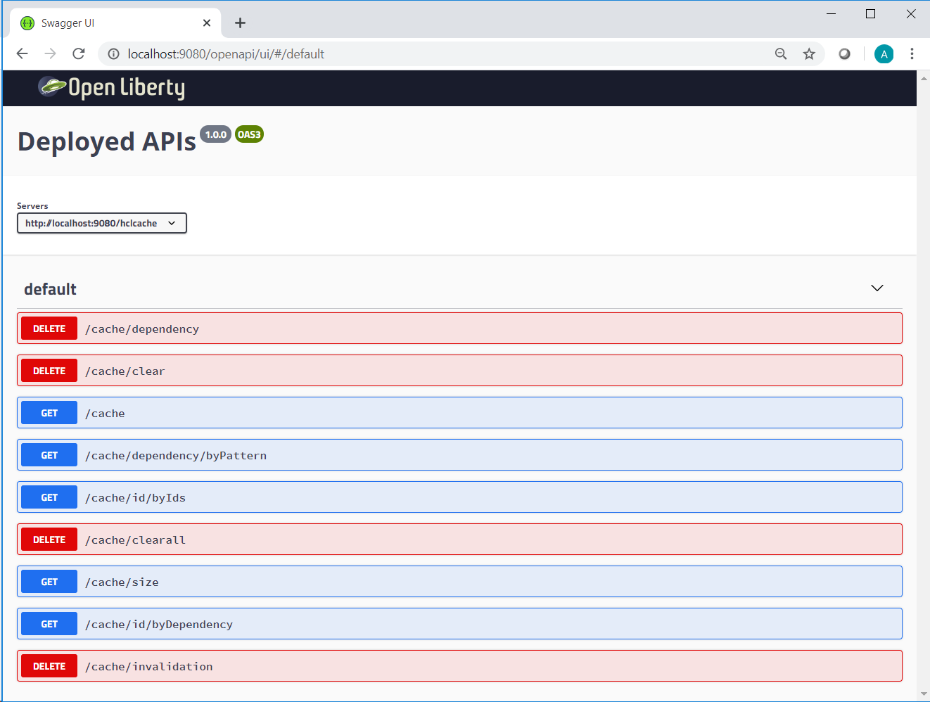
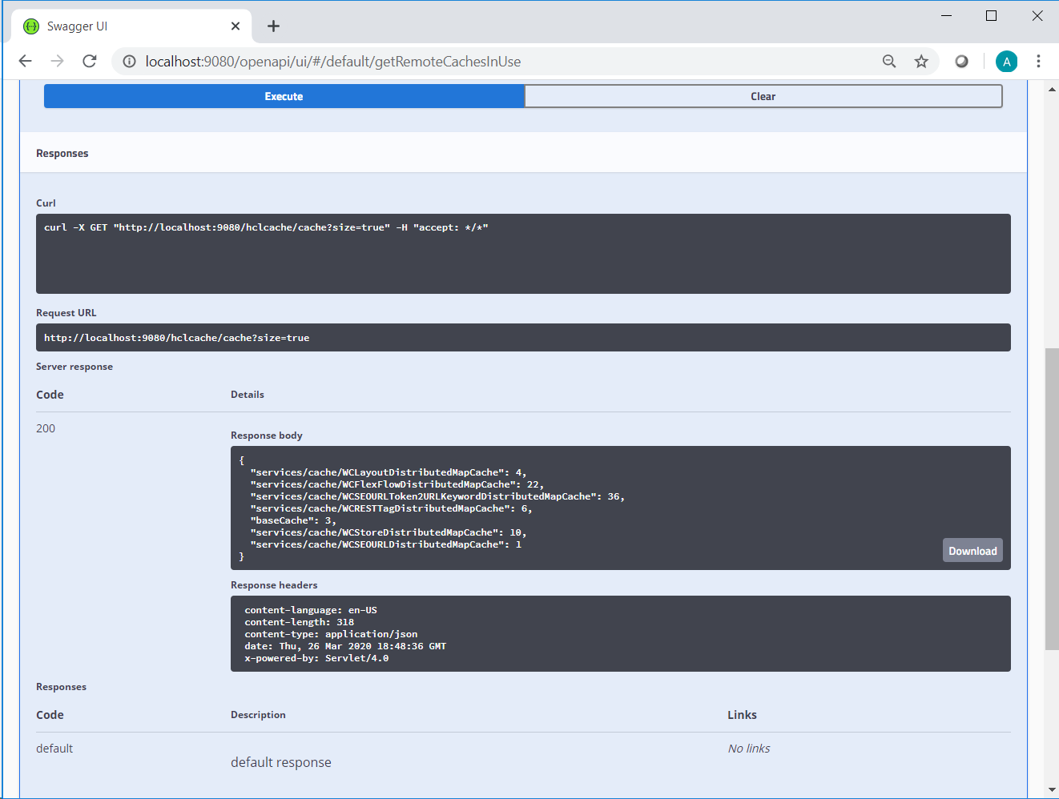
Operating the HCL Cache - HCL Cache App
~~ Internal Only (for now) ~~

Slide 17
Operating the HCL Cache - HCL Cache App
Deploy HCL Cache App Pod
kubectl apply -f hcl-cache.yaml -n commerce
Access the HCL Cache App via port-forwarding
kubectl port-forward hcl-cache-app -n commerce 9080:9080 &
Enable SSL tunnel in putty
Access the app from local browser: http://localhost:9080/openapi/ui/#/
<< Plan is to create an ingress configuration so port forwarding is not required >>
apiVersion: v1
kind: Pod
metadata:
name: hcl-cache-app
namespace: commerce
labels:
app: hcl-cache-app
spec:
containers:
- name: hcl-cache-app
image: comlnx94.prod.hclpnp.com/andres/hcl-cache-app:lastest
imagePullPolicy: Always
volumeMounts:
- name: hcl-cache-config
mountPath: /SETUP/hcl-cache/cache_cfg-ext.yaml
subPath: cache_cfg-ext.yaml
- name: hcl-cache-config
mountPath: /SETUP/hcl-cache/redis_cfg.yaml
subPath: redis_cfg.yaml
volumes:
- name: hcl-cache-config
configMap:
name: hcl-cache-config
optional: true
restartPolicy: Always
~~ Internal Only (for now) ~~

Slide 18
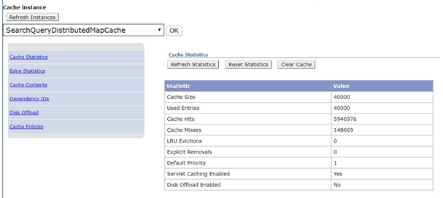
Monitoring HCL Cache – Cache Monitor
The Cache Monitor displays local cache statistics and cache entries
Some differences:
Update operations also affect remote caches (Invalidate/Remove/Clear)
Reset statistics button doesn’t work
This is intentional as the statistics shown in Cache Monitor are also forwarded to Micrometer/ Prometheus
Template column (when displaying cache entries) is empty (we don’t use it)

Slide 19
Monitoring HCL Cache – Cache Monitor
Optional configuration to log metrics
By default configured to 300 seconds (5 minutes) – It can be overridden in cache_cfg-ext.yaml logMetricsFrequency: 300
Metrics will be logged at the set interval
Local metrics are included, and remote from this POD’s perspective (e.g. number of remote invalidates – but only initiated by this pod)
Metrics can also be disabled with com.hcl.commerce.cache.MetricsLogger=off
2020-03-30 11:25:25 INFO CacheMetrics baseCache CacheMetrics {
"baseCache": {
"remote": {
"invalidates.duration.result.ok": "9127/27.3762 secs- avg: 3.00 ms",
"puts.duration.result.ok": "9126/28.5307 secs- avg: 3.13 ms"
},
"local": {
"size.current": "9127",
"puts.source.local": 9127,
"gets.result.hit": 91260,
"size.max": "5000",
"invalidates": 9127
}
}
}

Slide 20
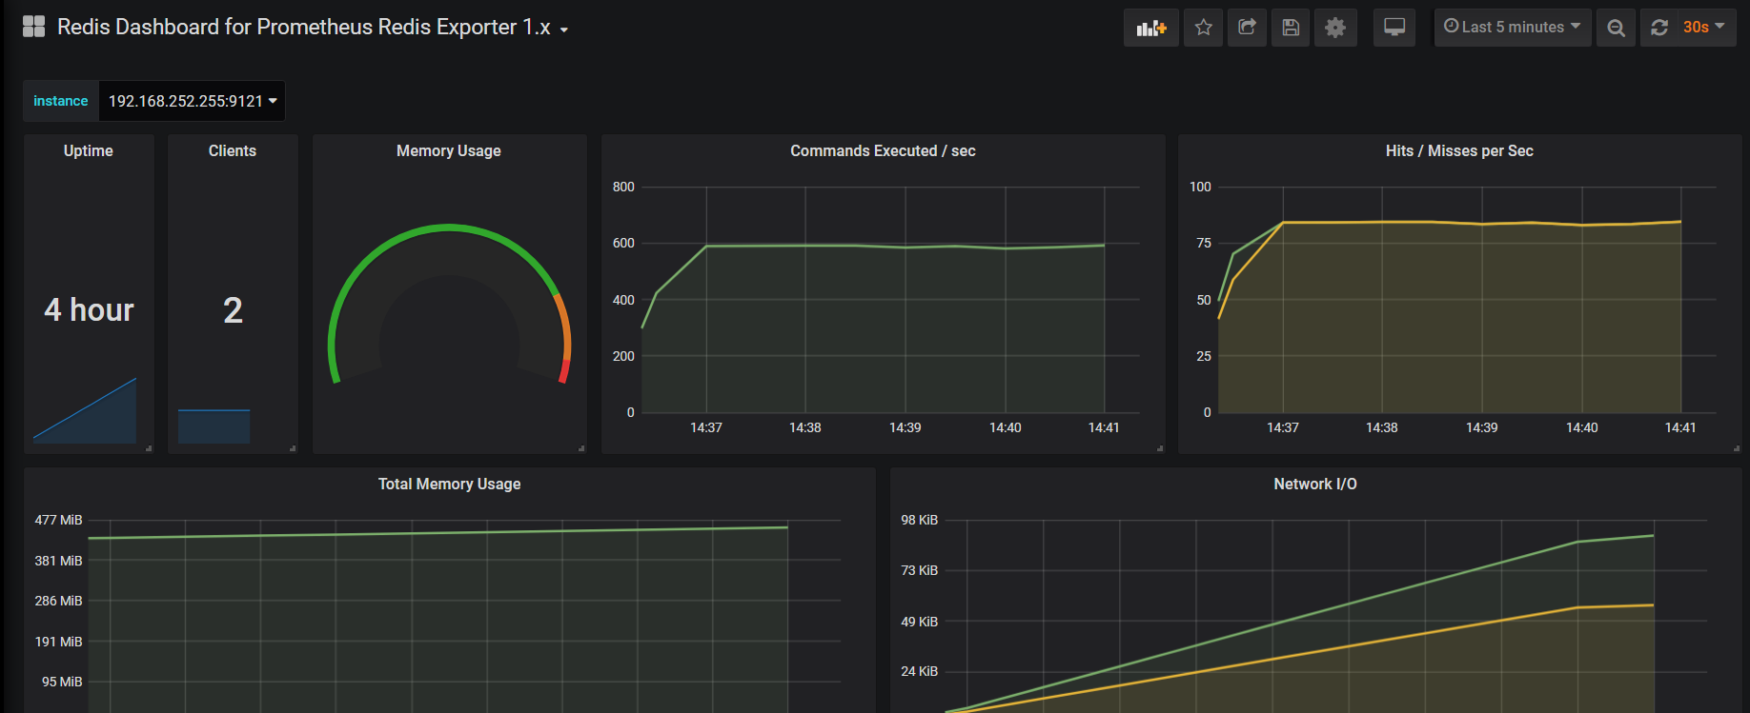
Monitoring HCL Cache – Remote Cache
Clients will have access to a variety of monitoring tools for server-side Redis
Redis on Kubernetes – enable Prometheus metrics exporter (Helm Chart option)
Redis running on cloud: Use cloud provider tools

